Slide 1
Blockchain

Slide 2
What is Blockchain Technology:
A blockchain public ledger that keeps a shared record of all the transactions ​distributed over a vast network of users. ​
It is decentralized network and doesn’t require any intermediate system for ​the exchange of services.​
The primary use of blockchains is as a distributed ledger for cryptocurrencies.
Example Bitcoin stores all its transactions onto a public database called as Blockchain.​
Blockchain placed information in a secure way because of it following cryptography hashing technic.

Slide 3
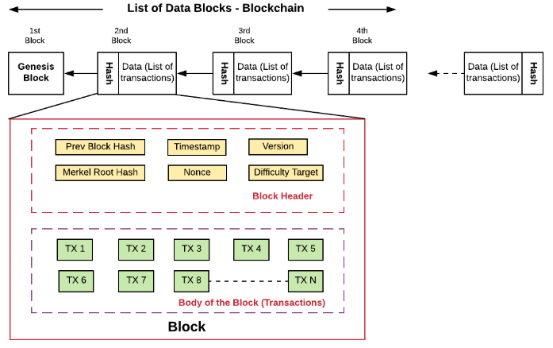
T
How Hashes are using in Blockchain:
Transactions
Transactions

Slide 4
A blockchain is a concept of storing data digitally.
This data comes in blocks. These blocks are chained together and make the data immutable.
When a block of data is chained with the other blocks, its data can never be changed again.

Slide 5
Blockchain is a System Comprised of:
Distributed ledger
Coinbase Transaction
Basic Components of Bitcoin
Blockchain Proof of work
Key Concepts of Bitcoin
Blockchain Key Areas
Blockchain Cryptocurrency
Blockchain DAO(Decentralized Autonomous Organization)
Blockchain Bitcoin Cash

Slide 6
Blockchain vs Bitcoin:
The goal of blockchain is to allow digital information to be recorded and distributed, but not edited. The Bitcoin protocol is built on the blockchain.
In a research paper introducing the digital currency, Bitcoin’s pseudonymous creator Satoshi Nakamoto referred to it as “a new electronic cash system that’s fully peer-to-peer, with no trusted third party.”

Slide 7
The key business benefits:
• Time savings
• Cost savings
• Tighter security
• Enhanced privacy
• Improved auditability
• Increased operational efficiency

